Slide 1
Lec 08: Managing Technology Uncertainties and Portfolio in Creating Economic Value
EEE 452: Engineering Economics and Management
M. Rokonuzzaman, PhD
Zaman.rokon.bd@gmail.com
www.the-waves.org
©️Rokonuzzaman
--use is permitted only for the purpose of EEE 452 (sections 1,2,3, 4 & 5 offered at NSU in Spring 2023);no consumption and distribution is allowed for any other purpose

Slide 2
Sources of Uncertainties in Taking Ideas to Market:
We all know that technology possibilities are fraught with pervasive uncertainties, creating decision making challenges. Some of the major sources of uncertainties are:
Technology
Consumer preferences
Competition response
Externalities—like infrastructure, 3rd party component plugins, etc.
Public policies and regulation
Spillover effects and multidimensional value extraction windows

Slide 3
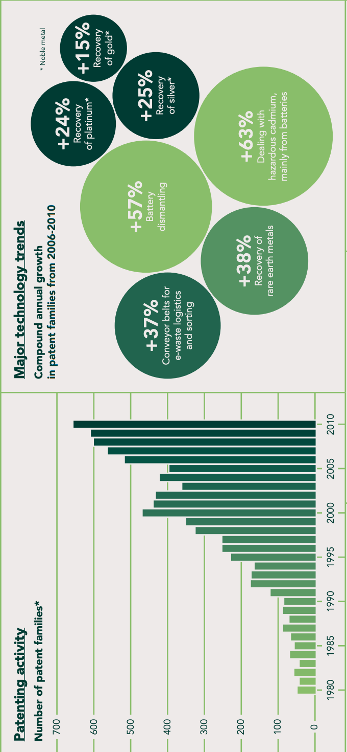
Technology Assessment, Monitoring and Tracking Monitoring Performance, Patents and Publications
Extrapolation of historical performance data is not enough to predict the likely future. Due to non-linearity, such practice may lead to significant deviation from the reality.
In addition to monitoring performance and fitting them within typical life cycle model (like S-Curve), we should also seek expert opinion, and keep monitoring patents and publications data.
In patent filings, significant disclosures are being made about the ideas, uniqueness, and likely application areas. Such data could be vital to understand likely directions along which progress is being made. Furthermore, patent monitoring will provide needed insights about technology gap, licensing opportunities, and legal issues pertaining to intellectual property infringement.
Scientific publications made in conferences, and journals provide valuable insights. Reports produced by Think Tanks, Industry Associations, Consulting houses, Government Departments, and Academic research centers carry valuable insights. Graduate Thesis reports are also insightful. Furthermore, opinion and review articles published by media outlets and websites are useful references to consult.
Data collected from those multiple sources should be fit into the framework to interpret the unfolding dynamics, and predict the likely future.
The surge in patenting activity since 2000 points strongly to the commoditization of e-waste as a source of high value materials, such as rare earth and noble metals.

Slide 4
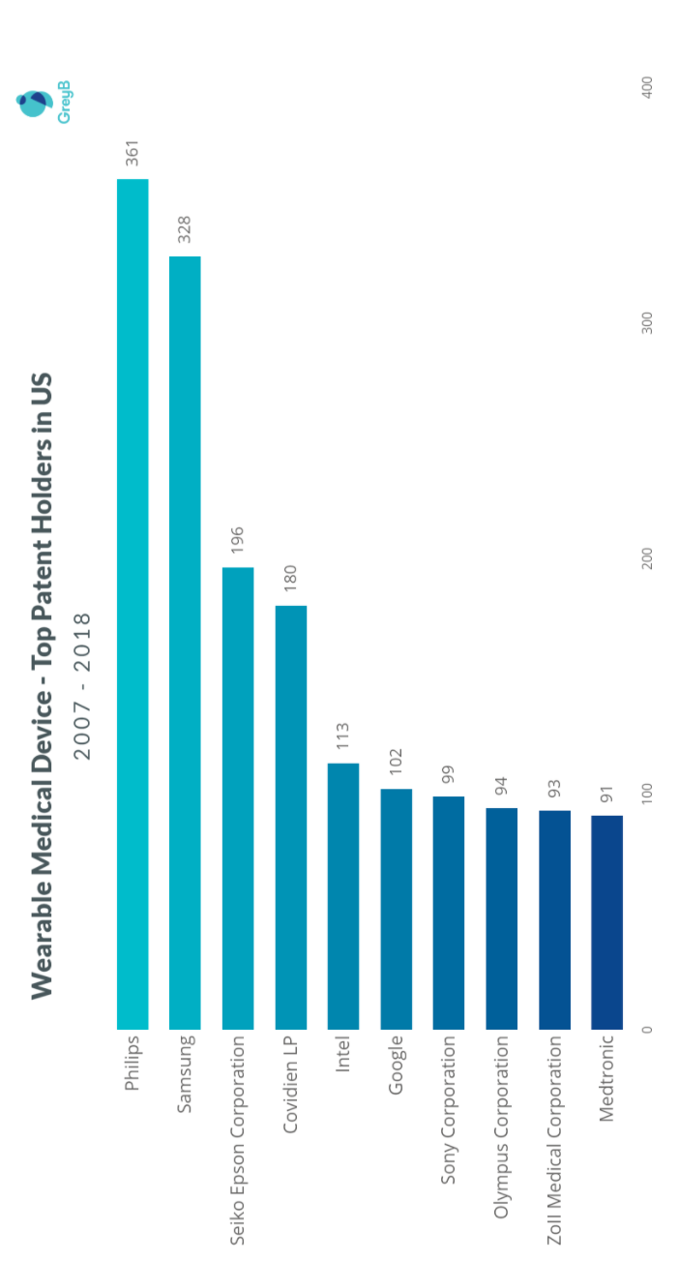
Benchmarking and Environmental Scanning—for detecting the trajectory
Benchmarking is the practice of comparing technology adoption and exploitation to industry bests and best practices from other companies. This benchmarking should take into consideration of patent filing by the best players of the industry.
It also looks into undertaken R&D projects by academic and industry players, and technology acquisition by the industry leaders, and also activities of new entrants. In certain cases, aggressive new entrants provide valuable insights about the likely unfolding future. For example, as opposed to GM or Ford, activities of new entrants like Tesla has been far more informative about the likely future of electric vehicles.
Environmental scanning pertains to monitoring the development of certain technologies and their adoption in different industries. For example, electronics was developed for the telecom industry. But it kept penetrating in other industries. Monitoring of such penetration provides valuable insights about its likely penetration in the target industry.
For example, although automobile used to be a typical mechanical engineering product, it has become highly semiconductor component intensive. Before penetrating the automobile industry, however, electronics penetrated in other industries.

Slide 5
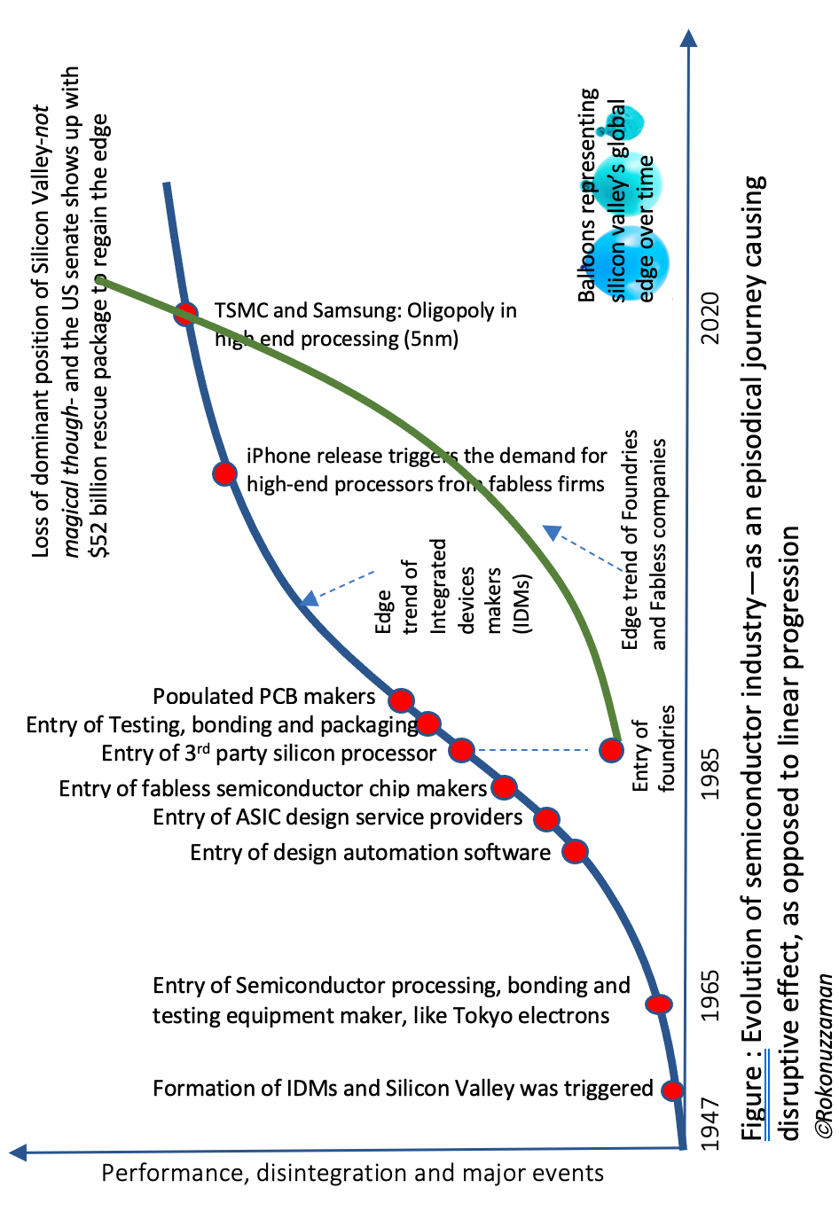
Detecting Discontinuity—with the potential of creating snowball effect
Monitoring should also take into consideration of detection of discontinuity, which often begins in a very humble form. Sometimes, a few of those beginnings lead to reinvention of the products and industries.
For example, in the 1980s, 3rd party silicon processors showed up to meet the silicon processing need for chip designers—as integrated device makers (IDM) like Intel or IBM were not interested to cater those small business opportunities. It began in a humble form to cater a very small market. But it was a discontinuity in shaping the future of the semiconductor industry down the road. After 30 years, 3rd party fabs have become far more technologically sophisticated than IDMs. In course of time, the whole industry has been monopolized around the 3rd party fabs like TSMC. As a result, mighty Silicon Valley has lost the edge to a tiny Island, Taiwan.
Often, such discontinuities are difficult detect, as they do not show up with a big bang. Furthermore, it does not take much resource to penetrate the industry through the discontinuity. However, invariably, all those discontinuities surface with very tiny and also loss making business proposition. The challenge is to envision the likely future, and start building flywheel or snowball effect turn by turn over prolonged period—even decades.
These discontinuities not only give the opportunity of creating big business out of a humble beginning, but also, most importantly, it causes destruction to incumbent business.
Similarly, iTune started the journey as a simple software that ripped your CDs into MP3 files. But that humble beginning lead to replacement of CDs with music downloading, leading to creating iPod and streaming success stories.

Slide 6
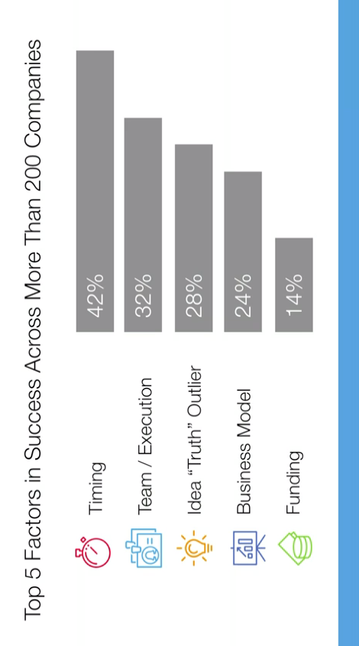
Timing and Strategy for Synchronized Response
Technology possibilities should be pursued in synchronization with related factors. Some of them are infrastructure, and complementary goods and services. On the other hand, technology maturity should be at optimum level—not too early or too late.
According to Bill Gross, founder of Idealab, the five key factors influencing startups’ success are the idea, team, business model, funding, and timing. Among them, timing is extremely important but can’t be controlled.
For instance, Bill Gross, the founder of Overture, back in the 1990s was already looking to an alternative search engine that would be based on natural language. Despite the innovativeness, however, the timing might have been too early. As semantic technologies were not mature enough to be the main component of search, and pervasive use of Internet was yet to pickup. As a result the whole endeavour became unfeasible.
Similarly, start-ups pursuing the idea of offering video content over the Internet 1990s did not succeed. In addition to low speed of Internet, TVs were analogue and all of them had cable connections. Change of consumer habit of watching video clips through smartphones and availability of smart TVs have made that once failed idea a success--Netflix.
Furthermore, many possibilities or ideas demand the synchronized response from multiple providers. Hence, timing and synchronization highly matter to produce economic value from technology possibilities.

Slide 7
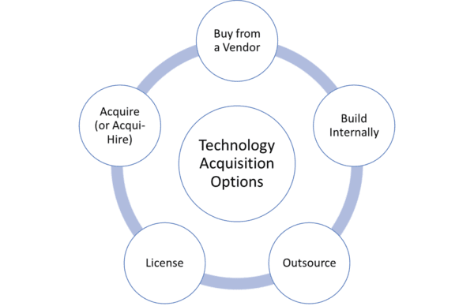
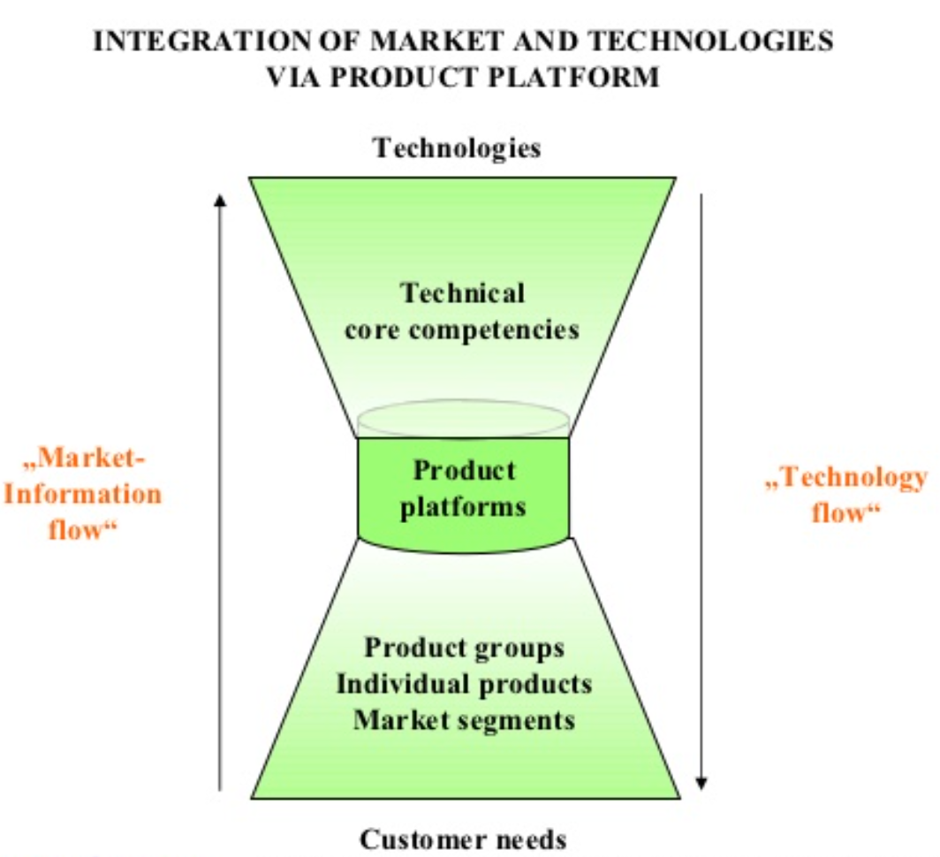
Technology Acquisition and Leveraging Options
Pursuing any technology possibility demands the acquisition of technology capability. Furthermore, a single possibility demands multiple technologies. Often, it’s not feasible to develop all the technologies internally. Hence, there is a need for careful investigations of alternatives and choosing the right options.
Choosing particular option depends the state of maturity, degree of relevance, need for being proprietary, lead time, costs, and any other relevant parameter.
Some of the specific practices for technology acquisition are (i) screening through technology auditing, (ii) valuation according to the value network in the perspective of whole product/service, (iii) prioritizing the relevance, transfer flexibility, competitive dynamics of technology, (iv) determining the timing criteria and scheduling sequence, and (v) selecting the modes of acquisition.
Some of the factors affecting technology acquisition options are (i) the relative technology power/position, (ii) the urgency of technology, (iii) the scale of investment/resource commitment, (iv) the stage of technology life cycle, and (v) the importance of degree of technology.

Slide 8
Technology Growth and Business Relevance
There should be a good match between technology portfolio and business opportunities being pursued. For example, to leverage emerging technologies, firms should have also competence of mature technologies too.
Major maturity stages of technologies and their relevance to business are below:
Emerging technologies are still under development and thus are unproved. But they have the possibility of supporting reinvention or adding major features.
Pacing technologies have yet to prove their full value but have the potential to alter the rules of competition by providing significant advantage. For example, lithium-ion battery has been a pacing technology for the automobile industry.
Key technologies have proved effectiveness, but they also provide a strategic advantage because not everyone uses them. For example, as of 2021, 5nm semiconductor technology has reached the status of key technology.
Base technologies are those that are commonplace in the industry; everyone must have them to be able to operate. For example, multi-touch based user interface is now the base technology for smartphone innovations.

Slide 9
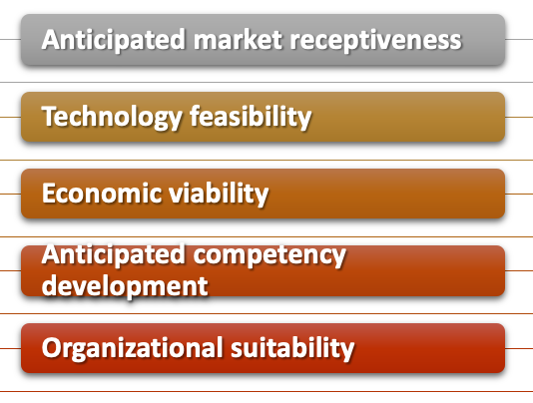
Factors Affecting Technology Leveraging Decisions
Once a technology possibility is observed, how far the market will be receptive or willing to pay for the features developed or advanced out of it should be carefully investigated. It should be followed up by the technology feasibility in offering envisioned features.
For example, despite the likely willingness to pay for autonomous driving, technology feasibility has become a barrier to leverage the market potential.
If there is a market for technologically feasible solutions, viability of profiting from it should be an issue. Among many other issues, price setting capability of dominant producers significantly determines the profit making opportunity. For example, due to price setting capability of dominant operator/s, other mobile operators are compelled to incur loss.
Often technology possibility appears in raw form. It demands internal organizational capability for further refinement and fusion—demanding a significant new competence. That competence development should be supported by suitable organizational culture and framework. Often, new possibility poses destructive threat to mature technology. Hence, existing organizational capacity may not be suitable to pursue new possibility. For example, incumbent organizational culture, politics, and business model could not allow Kodak to pursue digital imaging technology possibility.

Slide 10
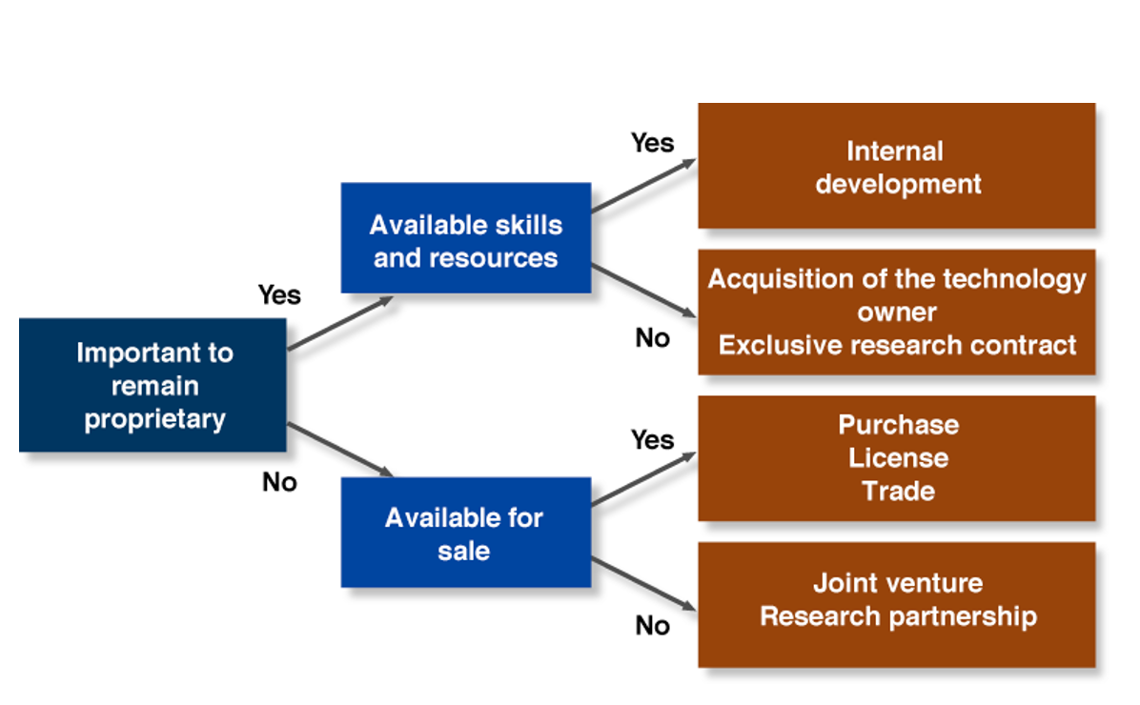
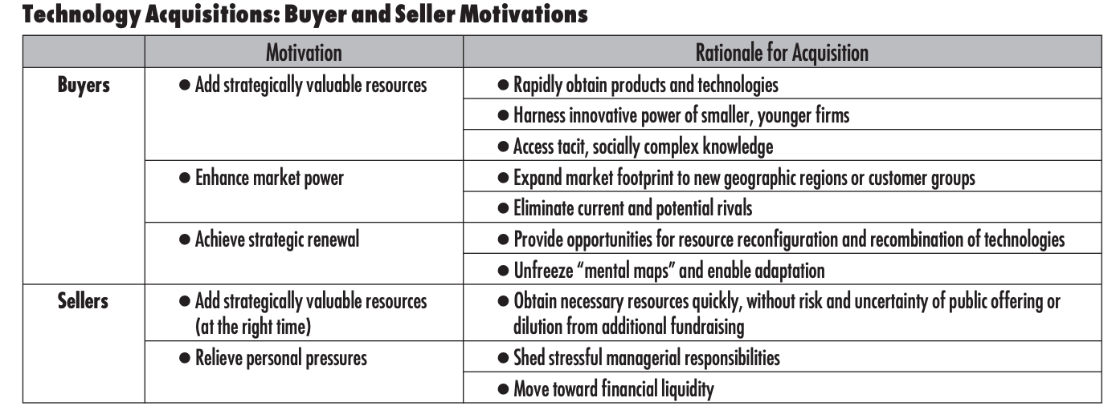
Technology Acquisition Decision Tree
Technology acquisition is a critical, expensive and time consuming process. It does not happen all of a sudden as it is desired. But the market demands timely response, often, unpredictable. Furthermore, all technology needs could not be met from internal development. They could not be fully sourced from the outside either. Hence, there should be a good balance between different approaches. To address it, we need a good decision making capability for adequately comparing multiple options.
Yet despite their strategic potential, many technology acquisitions fail to create value. The CEO of serial buyer Cisco Systems has estimated that the failure rate for technology acquisitions is as high as 90%.
Among many benefits, like improving products, acquisitions can enhance a buyer’s power by completely eliminating one or more potential rivals.

Slide 11
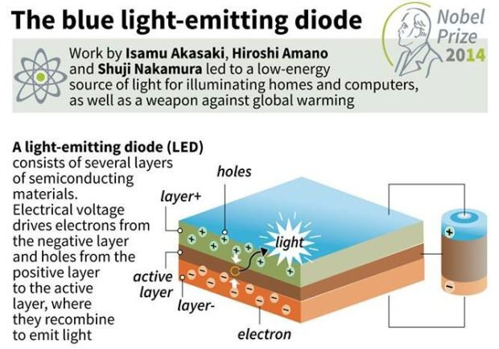
In-house Research and Development Capacity—critical requirement to scale up
In house R&D serves two important purposes. First of all, it develops some proprietary technologies. Refinement of technologies sourced from the outside is the 2nd purpose.
Invariably, technologies sourced from the outside needs continued refinement for fitting them within conceived architecture, and advancing them further. In the absence of the internal R&D capacity, leveraging of acquired technologies could not be maximized. Due to weakness of internal R&D, many firms or even countries cannot derive expected benefit from outside technologies.
Often, Apple is referred to as a role model in this regard. In retrospect, Apple sourced more or less all core technologies from the outside. But it did not use them as is. Instead, Steve Jobs developed internal R&D capacity and also the culture to refine them by stressing the commonly perceived limit—leading to magical performance. For example, neither GUI for PC nor multi-touch for iPhone Apple developed from the scratch. But upon sourcing them from the outside, Apple placed them under rigorous internal R&D for refinement.
By the way, further refinement of sourced coarse technologies demands very high level competence. For example, Japan’s Asahi Kasei got access to Lithium-ion battery from the academic work undertaken by the British and American Academics. Similarly, Sony got license for Transistor and Image sensor from Bell Labs. But none of those acquired technologies was feasible to derive economic benefit. Hence, their internal R&D team had to embark on refinement—even leading to Nobel Prize winning scientific discoveries.

Slide 12


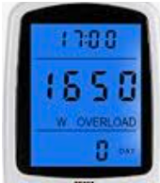


Progressive Roll Out for the Exploitation of Increasingly Complex Possibilities
To maximize economic value from technology possibilities and also reduce the risk of R&D investment, management should focus on progressive roll out of innovations.
For example, LCD technology found a large market in reinventing Television by changing the CRT technology core. But instead of waiting for the big catch, Japanese technology firms started exploiting the possibility when LCD was at its infancy. They started deriving the economic value from changing mechanical display of watches. Subsequently, upon making further advancement, they focused on replacing mechanical displays of instruments, and offering large screens to smartphones. Eventually, they reached the goal—reinventing TVs with large LCD flat displays.
Such progressive exploitation appears to be prudent management practice for reducing the risk and maximizing the gain. In certain cases, technology possibility stops growing or give up to a competing one. For example, despite showing early promises, plasma display technology gave it up to the uprising of LCD.
Performance of LCD
Progressive roll out of innovations

Slide 13
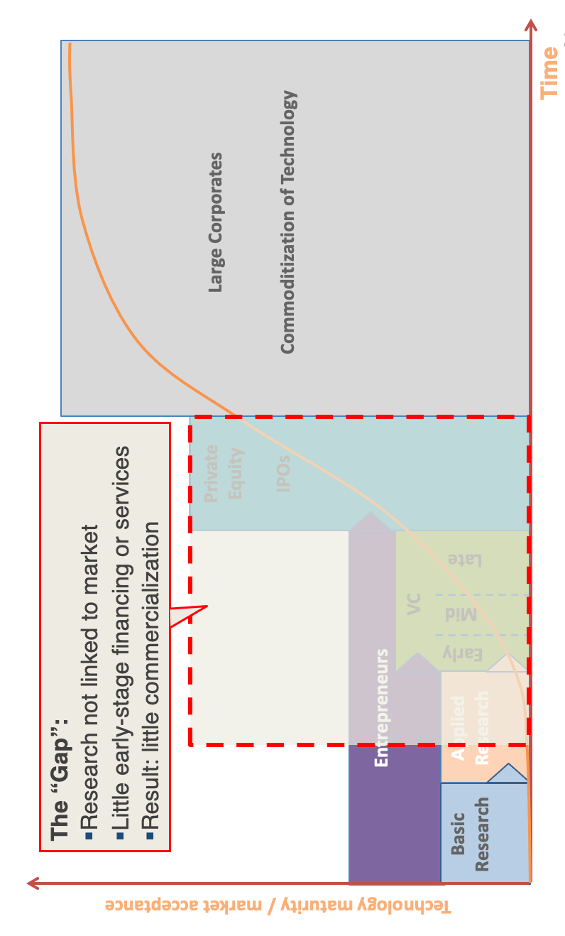
Addressing the Possibility Gaps
Whether from tinkering and systematic laboratory work, invariably, all technologies are born in primitive form. At the beginning, there have been no commercial value.
Yes, R&D grants help to demonstrate likely applications. But that is not sufficient to create willingness to pay among a large number of customers. Even, inventors’ own resource is not sufficient to advance the technology to reach the civilian market.
Hence, there has been a gap between the technology infancy and the adulthood needed for reaching the civilian market.
Historically, the Western world, particularly the USA and Germany, created the demand for the primitive emergence of great technologies for the purpose of military. Starting from Airplane to Mobile phones, there have been many examples.
In the recent time, venture capital (VC) funds have emerged. But unfortunately, unlike military, VC funds do not create market. VC fund managers are not either supportive to R&D for advancing infant technologies. Instead, they been after subsidies for rolling out premature products and practicing predatory pricing for monopolization.
In the absence of the military market, prudent approach has been to start from peripherial applications and progressively move towards more attractive ones. For example, the journey of LCD display offers valuable lesson.

Slide 14
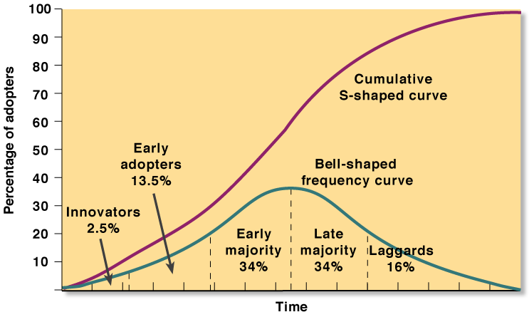
Synchronizing Technology Maturity and Diffusion in Customer Segments
Perceived value of technology keeps growing along with the advancement, as progression keeps improving quality and reducing the cost.
At the infancy, only a small segment of customers, having special need that could be served with infant technology better than any other means, become customers. For example, in the 1960s, taxi service providers found mobile phones—weighing 40kgs-- useful to communicate with individual taxis from the command and control center.
Further advancement of technology makes innovation around it attractive to larger group of customers—known as early adopters. For example, in the 1980s, mobile phones found applications as car phones.
Technology needs to keep making progress further in making them eligible to create economic value to far larger groups—like early majority and late majority. For example, in the 1990s, professionals started becoming customers of mobile phones, followed by households and all adults. In the 2010, people without having mobile phones started finding them isolated from the rest of the society, and eventually, they became compelled to adopt it. They belong to laggard group.
There is no doubt that early and late majority segments offer the largest economic value creation opportunity out of technology possibility. But in the absence of systematic value extraction from the previous two segments with premature product, technology possibility runs the risk of getting caught in the gaps.
Hence, systematic synchronization of technology progression, and progressive exploitation for economic value creation opportunity from different customer segments highly matters.
By the way, in the absence of technology advancement, subsidies and marketing campaign are not sufficient to profitable penetrate subsequent market segments.
Technology

Slide 15
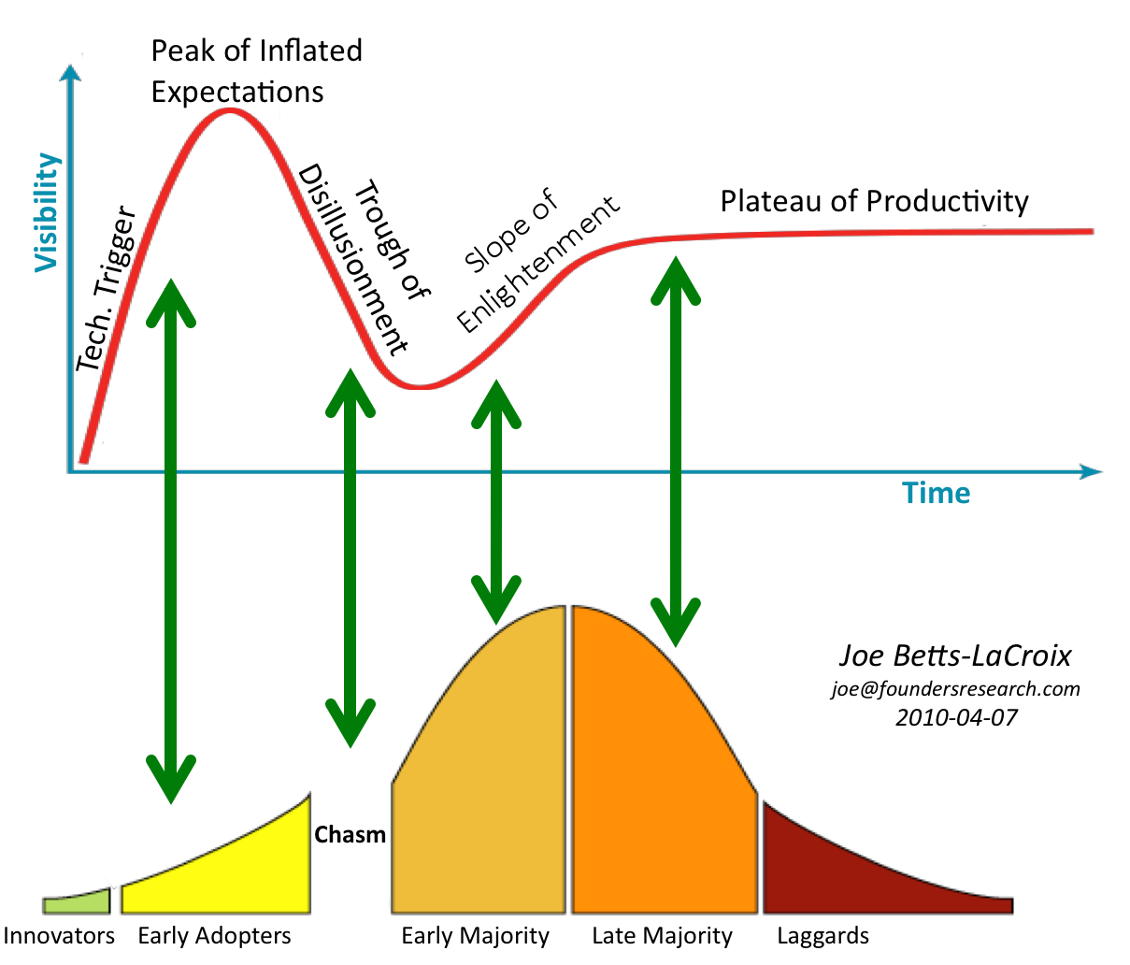
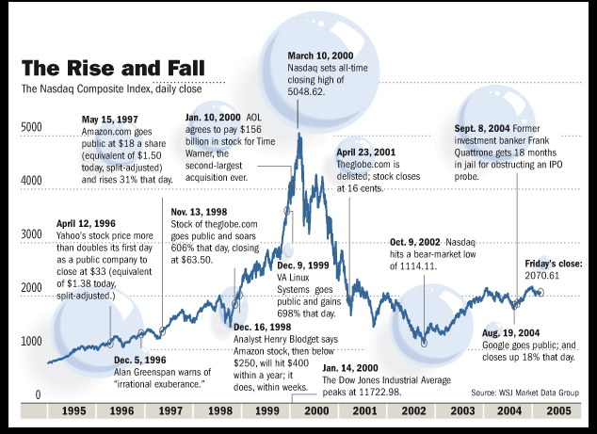
Crossing the Chasm
We are all aware of the dot-com bubble caused by excessive speculation of Internet-related companies in the late 1990s. Subsequently, it was followed by burst—making many .com startups bankrupt. This is a typical example of falling through the crack, even after getting initial successes.
Marketing high tech products during the early start up period causes the crossing the chasm phenomenon.
The fundamental theories in Crossing the Chasm, including the concept of a gap or chasm between the early adopters of a product and the mainstream early majority, were originally developed in 1988 and 1989 by a group of consultants.
Often the response of innovators and early adopters to emerging technology possibilities inflate expectation of market response. Unfortunately, further advancement of technology (quality improvement and cost reduction of innovations) is needed to create sufficient willingness to pay among the early majority. As a result, a gap or chasm is created. To overcome it, focus should be on further advancement of value propositions.

Slide 16
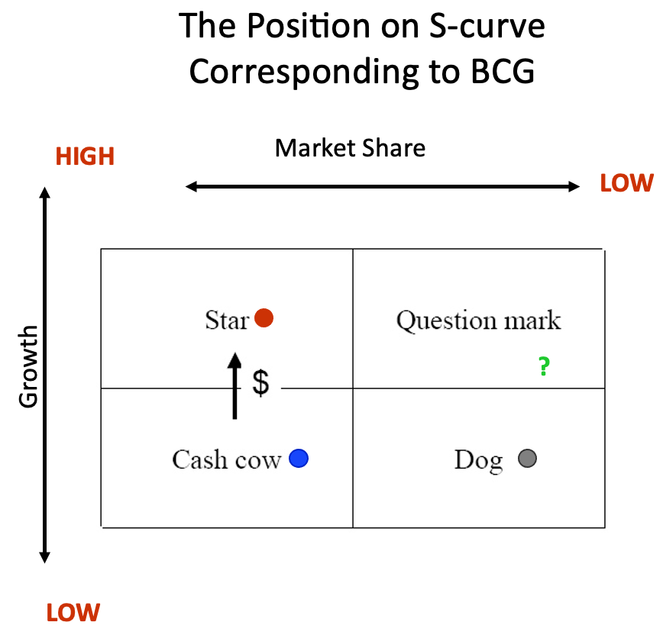
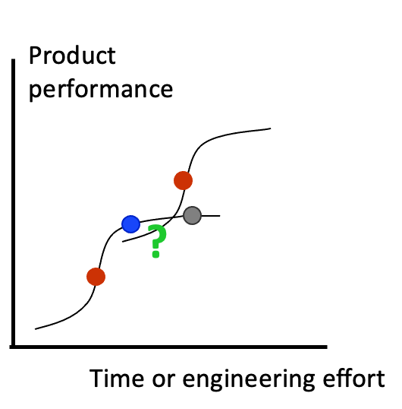
Managing a Balanced Portfolio of Products
With respect to the maturity of underlying technologies and rising of emerging waves, technology innovations can be categorized in four groups: i. Question mark, ii. Star, iii. Cash cow, and iv. Dog.
Around an emerging technology core, innovations appear in the market with a questionable response and future. For example, short messaging service (SMS) emerged in the mid 1990s, with a question mark. However, it rapidly grew as a star. But not all innovations grow like it. On an average, more than 80% innovations fail to grow as a star. Eventually, rising star performance of SMSs stabilized showing steady growth in revenue and profitability—attaining the cash cow status. However, due to the emergence of alternatives like FB, SMS innovation started losing its luster—becoming a dog progressing towards retirement.
Based on such life cycle of technology innovations, Boston consulting group developed a growth vs market share matrix. For example, a cash cow product has a large market share, but it suffers from slow growth.
It happens to be that there has been a correlation between product innovation and technology life cycles. There has been a need of strong synchronization among them. Hence, there should be strong focus on technology inventory for managing a balanced product portfolio.

Slide 17
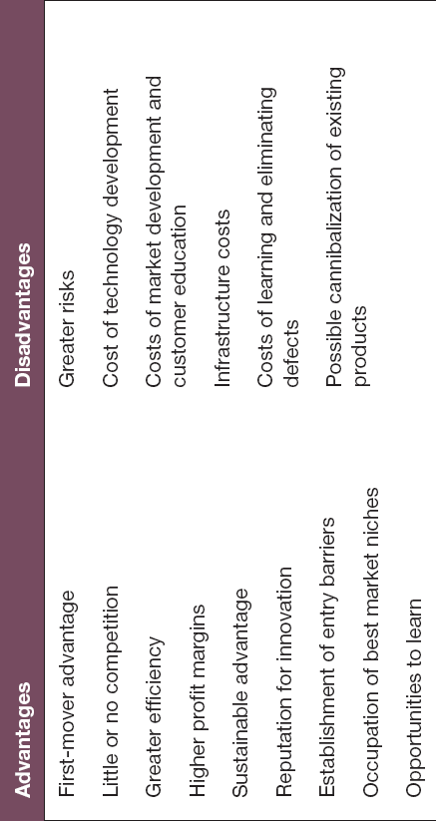
Should You Lead or Follow?
A technology leader finds uncontested virgin market. But is it sufficient to create profitable opportunity for just emerged technology possibility?
Not always, though. For example, Kodak was the first to get digital camera patent. Similarly, Motorola was the leader in developing a constellation of satellites—iridium--for offering mobile communication services. But they could not turn their early entry into profitable businesses.
But does it mean that being a leader is not a smart strategy in the exploiting technology possibility? Not always, though. In fact, technology leadership offers the opportunity of attaining price setting capability, leading to monopolization of an emerging market. For example, Xerox has done it very well in the photocopying market.
By exploiting technology progression, a leader may reach the capacity of offering the highest quality at the least cost—leaving no business opportunity to the followers. But that requires synchronized, consistent response.
On the other hand, a follower may focus on sharpening innovation ability in taking away market from the leader. Through higher speed of advancement, even a follower may establish leadership position around the same technology core. For example, being late entrants, Canon emerged as leader in Camera and Toshiba became a top performer in hard disk drive.
Eventually, the success is in leading. But that does not necessarily mean the first entry. For example, Google was not the fist company to offer search engine or Microsoft was not first word processor provider either.

Slide 18
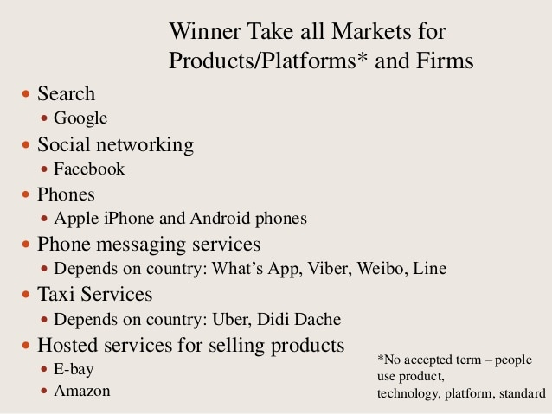
Winners Take All—Imperfect Market
Competition of market economy is vital for the rapid growth of technology possibilities—in offering increasing quality at decreasing cost. But the ability of offering higher quality products at decreasing cost by exploiting technology advancement leads to price setting capability.
Quality advancement comes from a number of areas, including leveraging externality effects. On the other hand, quality advancement has a tendency of reducing the cost too. For example, defect reduction improves the quality and reduces wastages and the need for support services.
Particularly, zero cost of copying software and the exponential nature of network externality effects create high economies of scale and scope effects—leading to creating imperfect market. Instead of the equilibrium between the supply and demand, dominant provider sets the price for making profit, while compelling competitors to take lower price for their inferior products produced at a higher cost. As a result, number of producers starts decreasing, leading monopoly, duopoly or oligopoly.
For example, in the 1980s, there were more than 30 word processor software producers. But the dawn of the 21st century found monopoly. However, it’s not limited within software innovations. Due to this effect, silicon chip processing industry has been witnessing decreasing number of firms—leading to two in offering high-end, 5nm services.
Winner Price setter
Follower Price taker
Technology
Quality
Technology performance, quality and cost
Cost
Time

Slide 19
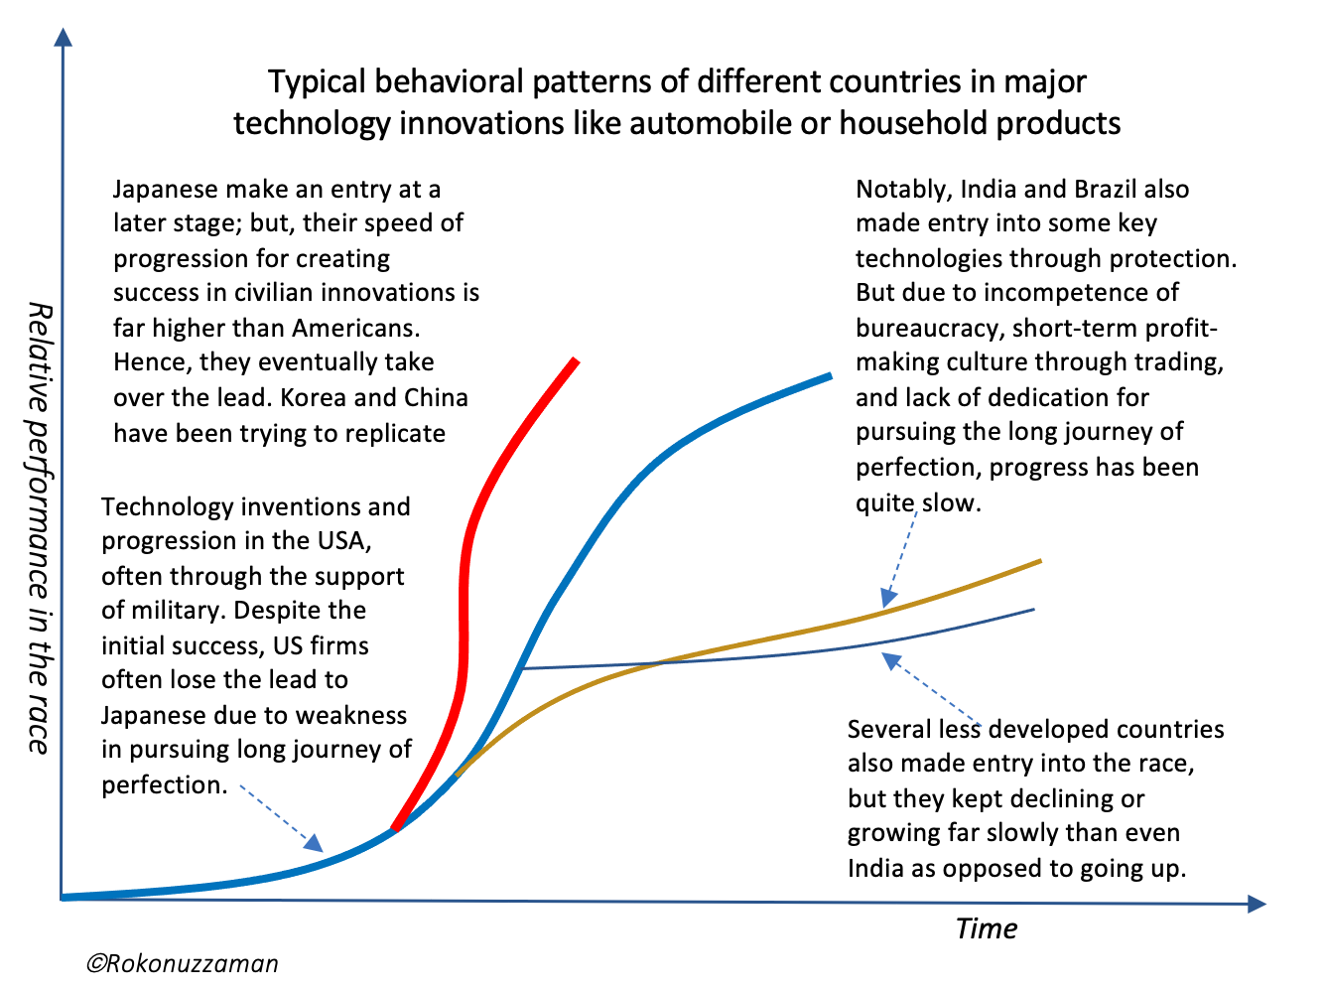
Followers Succeed to Lead—not always though
In certain cases, followers may succeed to lead and take away the price setting capability. Invariably, that demands faster incremental progression, reinvention and leveraging discontinuity.
For example, Apple was follower in the smartphone industry. To create an entry and attain the price setting capability, Apple reinvented smartphones and kept improving it at a higher speed-giving little scope to followers to catch up.
Canon and Honda were late entrants in the Camera and automobile businesses respectively. But they showed far higher incremental progression rate than their competitors. As a result, they have over taken the lead, establishing them as market leaders.
On the other hand, some Indian firms made an entry through import substitution strategy. Unlike Japanese firms, they focused on keep making the same thing. As a result, they kept falling behind, leading to departure—let alone growing as leader.

Slide 20
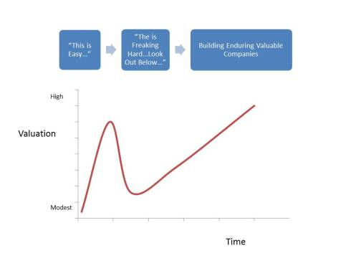
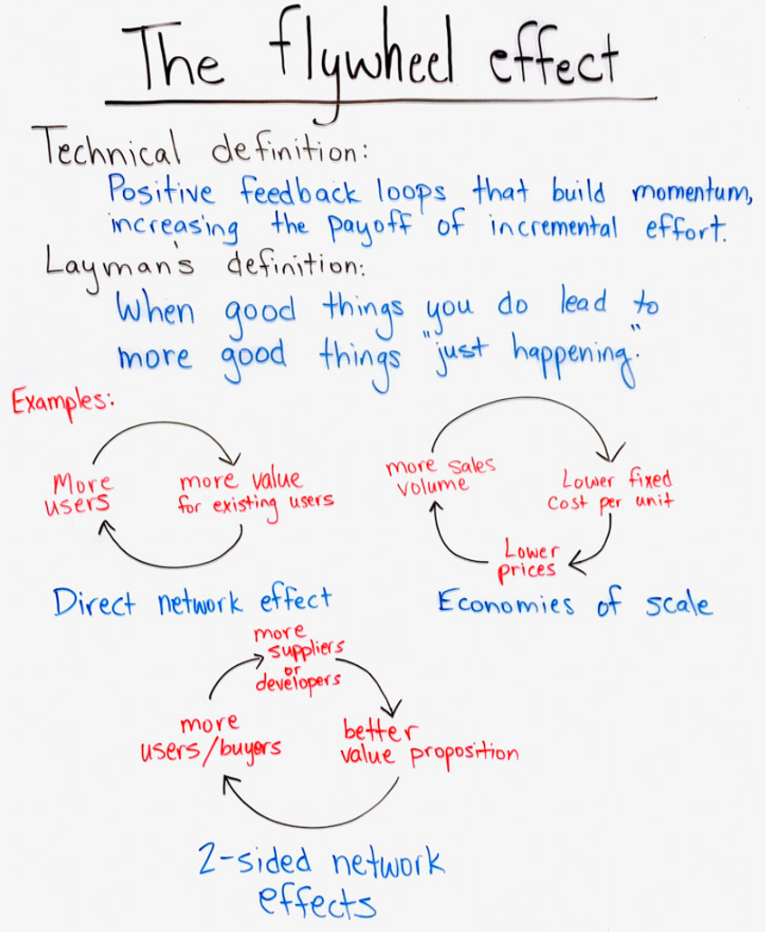
Building Flywheel Effect —Cumulative Effect of Incremental Progression
Creating the flywheel effect is a concept of keep adding momentum by creating cumulative effect from incremental progression. It’s about creating a positive feedback loop for adding momentum from the addition of one after another idea—in a consistent direction.
For example, keep reducing the weight of the battery through consistent flow of ideas in storing more energy per unit of material has been creating the flywheel effect. Similarly, keep increasing the perceived value of smartphone by adding software apps, without increasing the material cost, has been building the momentum of penetrating deeper into the market.
Often, such flywheel effect building continues for decades. For example, momentum building of silicon chips or gasoline based automobile has been progressing till today.
In fact, creating the flywheel effect is a critical requirement for succeeding in creating economic value from technology possibilities. It requires an appropriate leadership, institutional capacity, and organizational culture.
However, the failure to stop the flywheel effect through self-destruction runs the risk of painful disintegration.

Slide 21
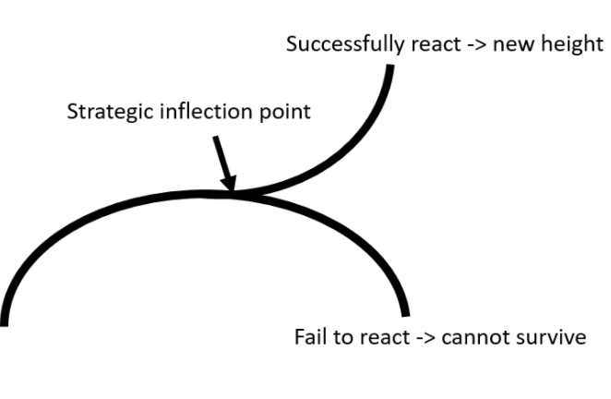
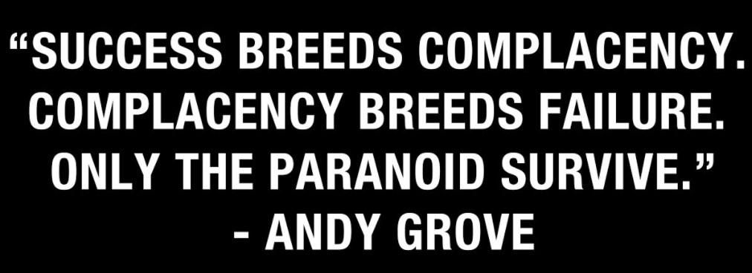
Regenerate Out of Self-Destruction
At the maturity of consistently creating flywheel effect, often, the success of reaching breakthrough performance breeds complacency. It gives the temptation of keep catching fish in the blue ocean. However, it’s a sign of danger of facing the consequence of creative destruction.
Breakthrough performance stage demands the plunging into recreation through self-destruction. Invariably, the peak of performance is associated with slow growth due to the maturity of the underlying technology core. It demands the recreation by reinventions through changing of technology core. As reinventions emerge in inferior form, invariably, incumbent high performers avoid to plunge into the recreation.
However, new entrants take it as an opportunity. They plunge into the mission of reinvention. Sometimes, reinvention waves grow and cause destruction to once high performing firms.
Succeeding in both creating flywheel effect and pursuing doom loop for recreation appears to be highly challenging. It seems that management practice and organizational structure in reaching breakthrough performance out of creating flywheel effect are highly inappropriate for deliberately triggering doom loop. Ironically, often, management thinkers term the triggering of the doom loop as a blunder. But, the dynamics of technology possibilities offer opposite lesson.

Slide 22
Technology Competence is not Good Enough
Economists, STEM community, and development thinkers are under the opinion that there appears to be a natural correlation between technology competence and economic value creation. Hence, there has been unquestionable intervention in increasing budget for education and R&D.
But it seems that economic value creation out of technology possibilities is fraught with pervasive uncertainties. Furthermore, although freedom of competition is vital for advancing technologies, flywheel effect in consistently improving the quality and reducing the cost leads to imperfect market—price setting capability as opposed to invisible hand.
Although winners take all by exploiting emerging technology possibilities, but early entry is not good enough. Often, followers succeed to take away the lead.
Furthermore, the success of profiting from technology possibilities, even after attaining price setting capability, is transient. This is due to the fact that, often, high performing incumbent players fail to recreate out of self-destruction.
There has been a need for strong management practice in dealing with uncertainties for creating economic value out of technology possibilities by attaining price setting capability.

